Slide 1
Amortized optimization
Brandon Amos
Meta AI NYC, Fundamental AI Research (FAIR)
brandondamos
bamos.github.io
github.com/facebookresearch/amortized-optimization-tutorial
github.com/bamos/presentations

Slide 2
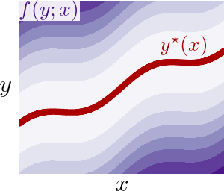




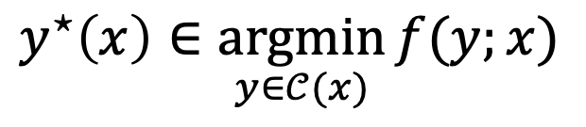
Optimization is crucial technology
Optimization is a modeling and decision-making paradigm and encodes reasoning operations
Finds the best way to interact with a representation of the world
Focus: parametric optimization problems that are repeatedly solved
optimal solution
objective
context (or parameterization)
$$y^{⋆}\left(x\right)∈\underset{y∈𝒞(x)}{argmin}{f(y;x)}$$
optimization variable
constraints
vertical slices are optimization problems

Slide 3
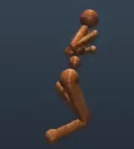
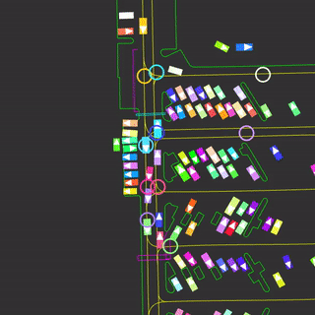
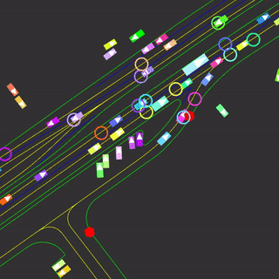
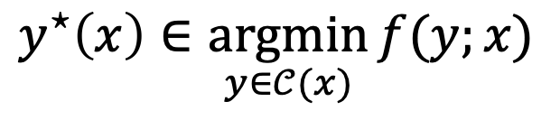
Breakthroughs enabled by optimization include
​controlling systems (robotic, autonomous, mechanical, and multi-agent)
optimal solution
objective
context (or parameterization)
$$y^{⋆}\left(x\right)∈\underset{y∈𝒞(x)}{argmin}{f(y;x)}$$
optimization variable
constraints

Slide 4
Breakthroughs enabled by optimization include
​controlling systems (robotic, autonomous, mechanical, and multi-agent)
​​making operational decisions based on future predictions
efficiently transporting or matching resources, information, and measures
​​​allocating budgets and portfolios
​designing materials, molecules, and other structures
​solving inverse problems (to infer underlying hidden costs, incentives, geometries, terrains)
​parameter learning of predictive and statistical models
optimal solution
objective
context (or parameterization)
$$y^{⋆}\left(x\right)∈\underset{y∈𝒞(x)}{argmin}{f(y;x)}$$
optimization variable
constraints
Notes:
this talk: not parameter optimization

Slide 5
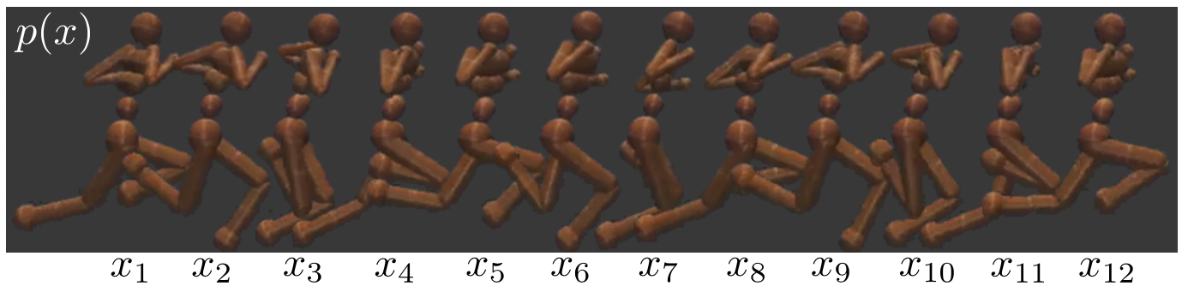
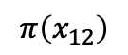
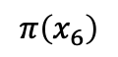
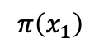
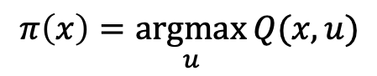
Repeatedly solving optimization problems
Tutorial on amortized optimization for learning to optimize over continuous domains. Amos, Foundations and Trends in Machine Learning 2023.
On the model-based stochastic value gradient for continuous reinforcement learning. Amos et al., L4DC 2021.
$$π\left(x_{1}\right)$$
$$π\left(x_{6}\right)$$
$$π\left(x_{12}\right)$$
value
action
action
action
$$π\left(x\right)=\underset{u}{argmax}{Q(x,u)}$$

Slide 6
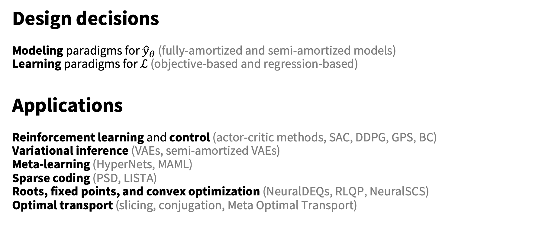
This talk: amortized optimization
Design decisions
Modeling paradigms for ${\hat{y}}_{θ}$ (fully-amortized and semi-amortized models)
Learning paradigms for $ℒ$ (objective-based and regression-based)
Applications
Reinforcement learning and control (actor-critic methods, SAC, DDPG, GPS, BC)
Variational inference (VAEs, semi-amortized VAEs)
Meta-learning (HyperNets, MAML)
Sparse coding (PSD, LISTA)
Roots, fixed points, and convex optimization (NeuralDEQs, RLQP, NeuralSCS)
Optimal transport (slicing, conjugation, Meta Optimal Transport)

Slide 7
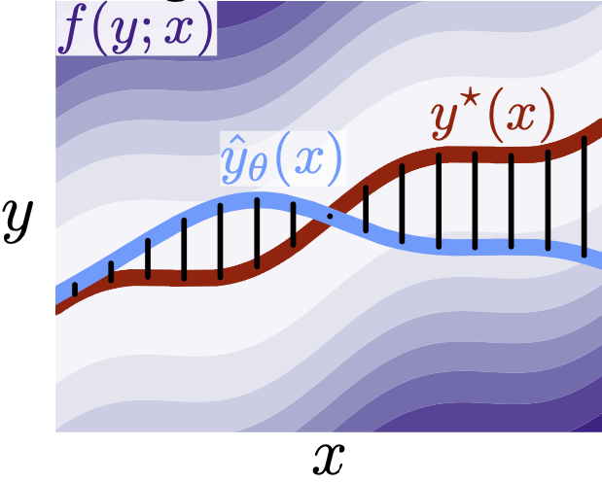
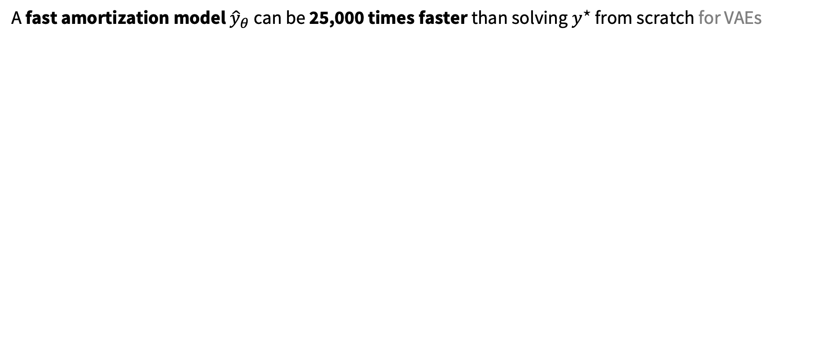
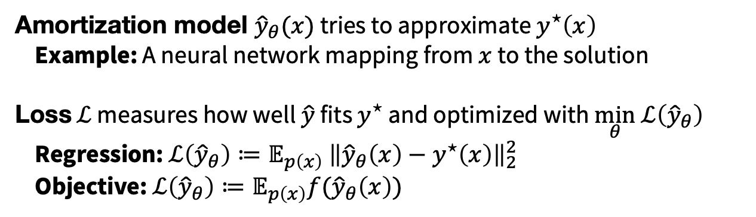
Amortization: approximate the solution map
Tutorial on amortized optimization for learning to optimize over continuous domains. Amos, Foundations and Trends in Machine Learning 2023.
A fast amortization model ${\hat{y}}_{θ}$ can be 25,000 times faster than solving $y^{⋆}$ from scratch for VAEs
Amortization model ${\hat{y}}_{θ}(x)$ tries to approximate $y^{⋆}\left(x\right)$
Example: A neural network mapping from $x$ to the solution
Loss $ℒ$ measures how well $\hat{y}$ fits $y^{⋆}$ and optimized with $\min_{θ} ℒ\left({\hat{y}}_{θ}\right)$
Regression: $ℒ\left({\hat{y}}_{θ}\right)≔𝔼_{p\left(x\right)} {\left\|{\hat{y}}_{θ}\left(x\right)−y^{⋆}\left(x\right)\right\|}_{2}^{2}$
Objective: $ℒ\left({\hat{y}}_{θ}\right)≔𝔼_{p\left(x\right)}f({\hat{y}}_{θ}\left(x\right))$

Slide 8
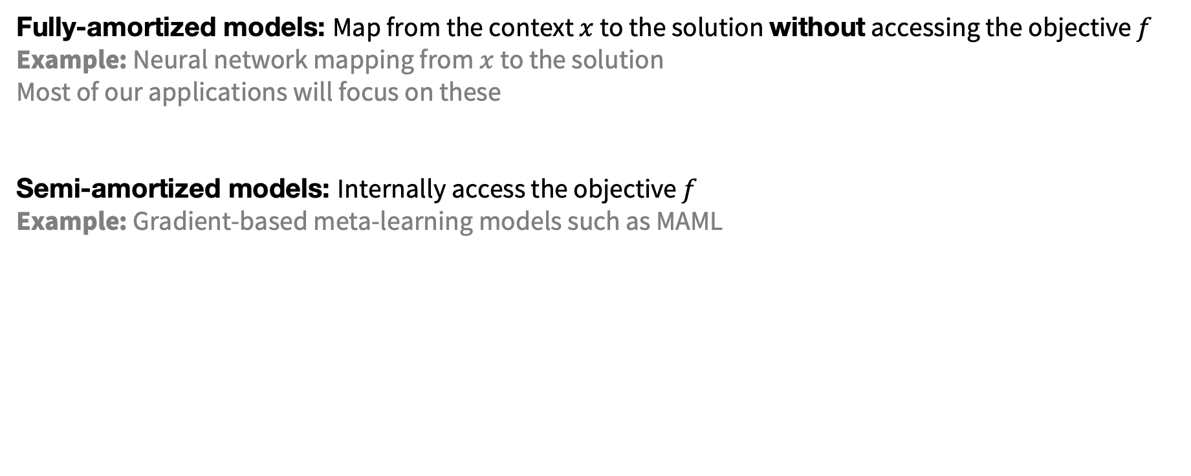

Modeling paradigms for ${\hat{y}}_{θ}$
How to best-predict the solution?
Fully-amortized models: Map from the context $x$ to the solution without accessing the objective $f$
Example: Neural network mapping from $x$ to the solution
Most of our applications will focus on these
Semi-amortized models: Internally access the objective $f$
Example: Gradient-based meta-learning models such as MAML

Slide 9
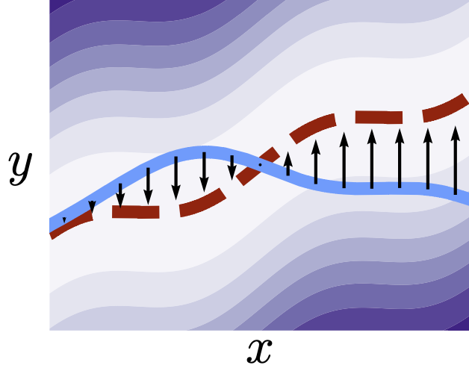
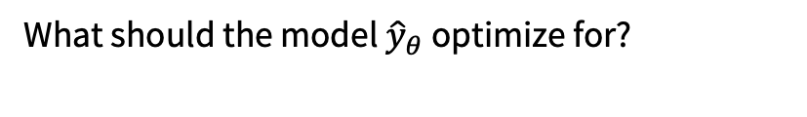
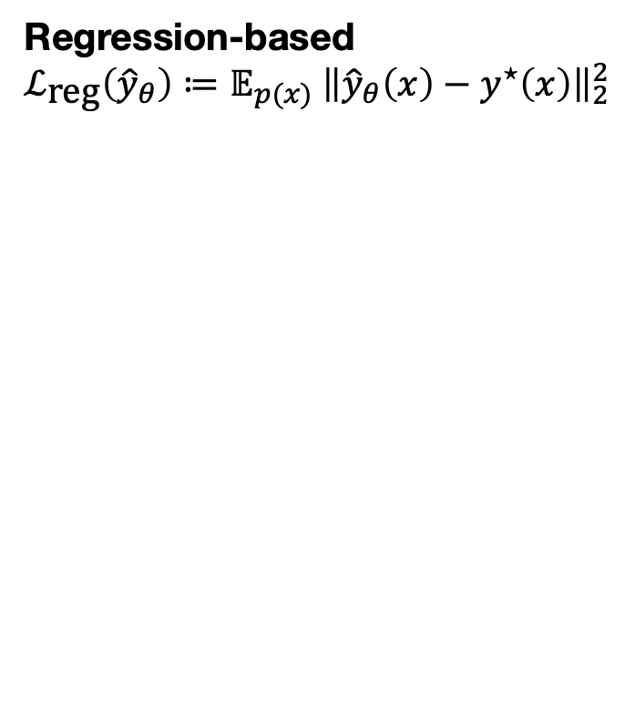

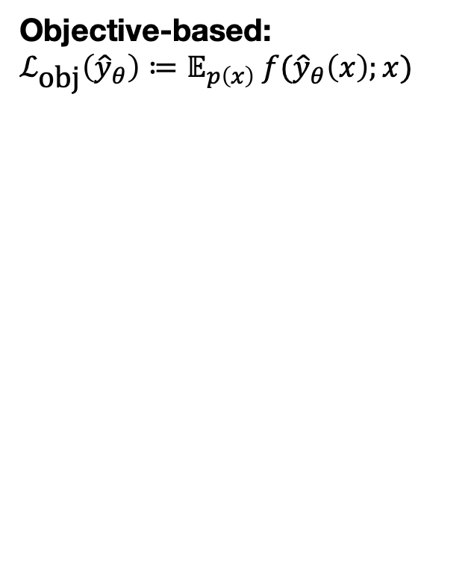
Learning paradigms for $ℒ$
What should the model ${\hat{y}}_{θ}$ optimize for?
Regression-based
$$ℒ_{\text{reg}}\left({\hat{y}}_{θ}\right)≔𝔼_{p(x)} {\left\|{\hat{y}}_{θ}\left(x\right)−y^{⋆}\left(x\right)\right\|}_{2}^{2}$$
Objective-based:
$$ℒ_{\text{obj}}\left({\hat{y}}_{θ}\right)≔𝔼_{p\left(x\right)} f({\hat{y}}_{θ}\left(x\right);x)$$

Slide 10
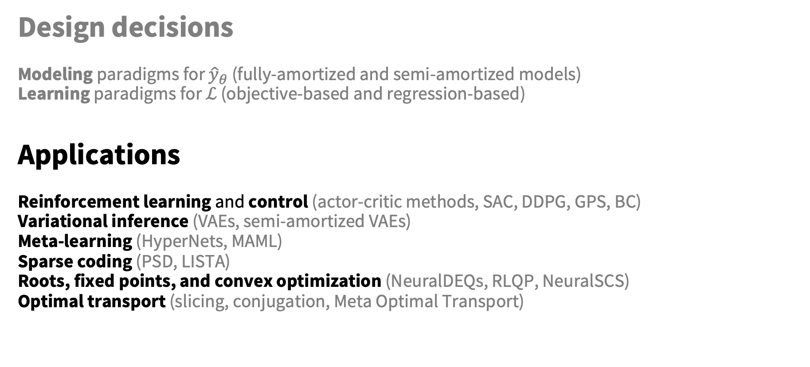
This talk: amortized optimization
Design decisions
Modeling paradigms for ${\hat{y}}_{θ}$ (fully-amortized and semi-amortized models)
Learning paradigms for $ℒ$ (objective-based and regression-based)
Applications
Reinforcement learning and control (actor-critic methods, SAC, DDPG, GPS, BC)
Variational inference (VAEs, semi-amortized VAEs)
Meta-learning (HyperNets, MAML)
Sparse coding (PSD, LISTA)
Roots, fixed points, and convex optimization (NeuralDEQs, RLQP, NeuralSCS)
Optimal transport (slicing, conjugation, Meta Optimal Transport)

Slide 11
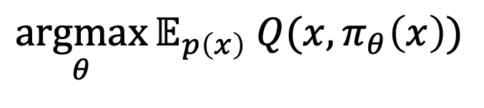
Applications of amortized optimization
Tutorial on amortized optimization for learning to optimize over continuous domains. Amos, Foundations and Trends in Machine Learning 2023.
Reinforcement learning and control (actor-critic methods, SAC, DDPG, GPS, BC)
$$\underset{θ}{argmax}{𝔼_{p\left(x\right)} Q(x, π_{θ}\left(x\right))}$$

Slide 12
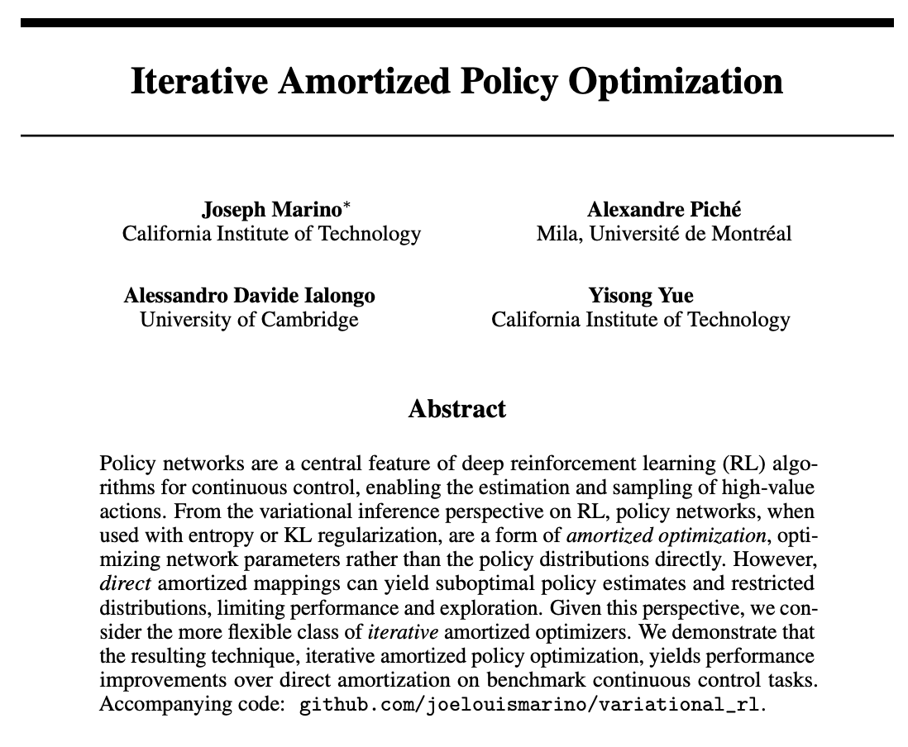
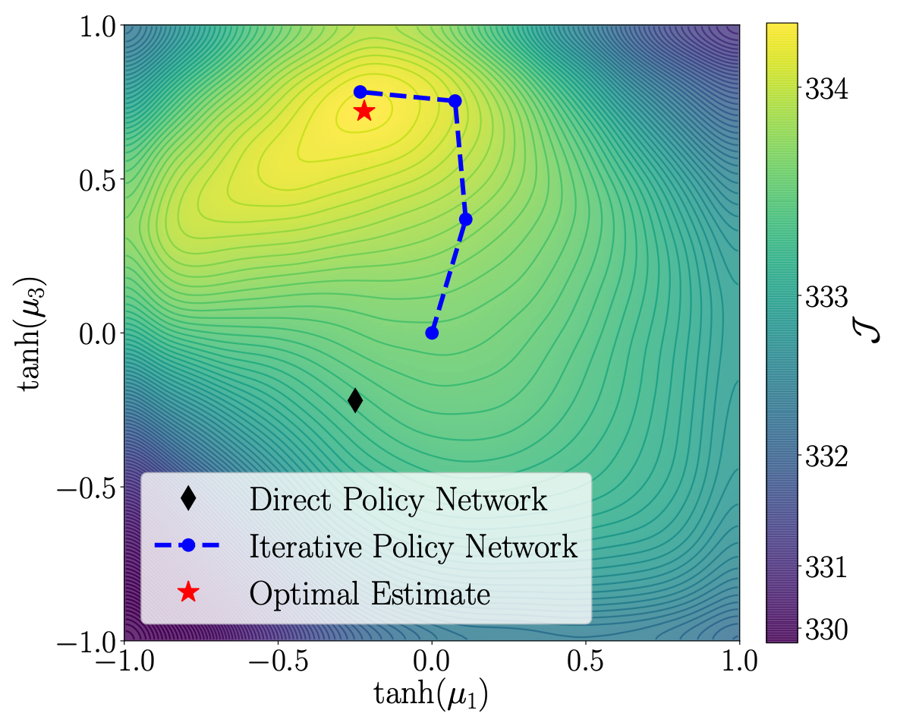
Applications of amortized optimization
Tutorial on amortized optimization for learning to optimize over continuous domains. Amos, Foundations and Trends in Machine Learning 2023.
Reinforcement learning and control (actor-critic methods, SAC, DDPG, GPS, BC)

Slide 13
Applications of amortized optimization
Tutorial on amortized optimization for learning to optimize over continuous domains. Amos, Foundations and Trends in Machine Learning 2023.
Reinforcement learning and control (actor-critic methods, SAC, DDPG, GPS, BC)
Hanabi scores
Ms. Pacman scores

Slide 14
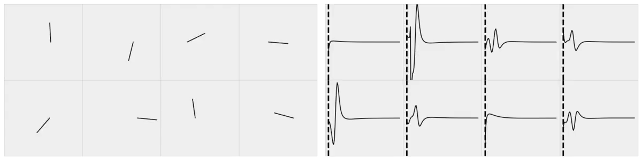
Applications of amortized optimization
Tutorial on amortized optimization for learning to optimize over continuous domains. Amos, Foundations and Trends in Machine Learning 2023.
Full control sequence space
Reinforcement learning and control (actor-critic methods, SAC, DDPG, GPS, BC)
Amortize by learning a latent subspace of optimal solutions
Only search over optimal solutions rather than the entire space
Subspace of optimal solutions
The differentiable cross-entropy method. Amos and Yarats, ICML 2020.
Cartpole videos
Optimal controls over time — force on the cartpole

Slide 15
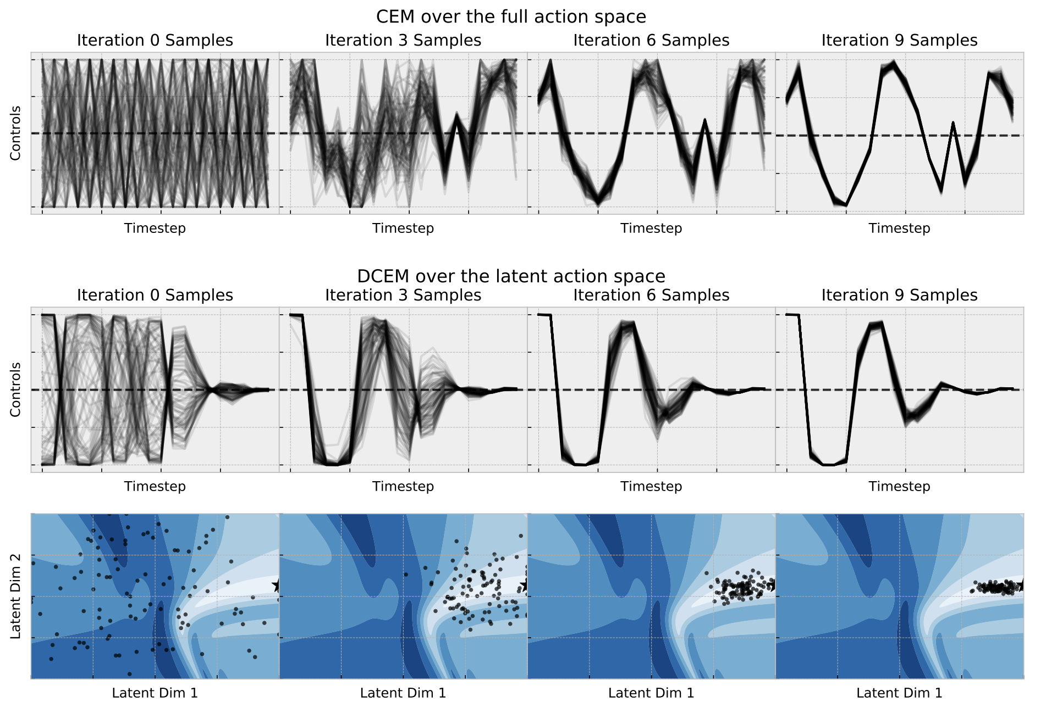
Applications of amortized optimization
Tutorial on amortized optimization for learning to optimize over continuous domains. Amos, Foundations and Trends in Machine Learning 2023.
Reinforcement learning and control (actor-critic methods, SAC, DDPG, GPS, BC)
Amortize by learning a latent subspace of optimal solutions
The differentiable cross-entropy method. Amos and Yarats, ICML 2020.
Full control sequence space
Subspace of optimal solutions
Latent space of optimal solutions

Slide 16

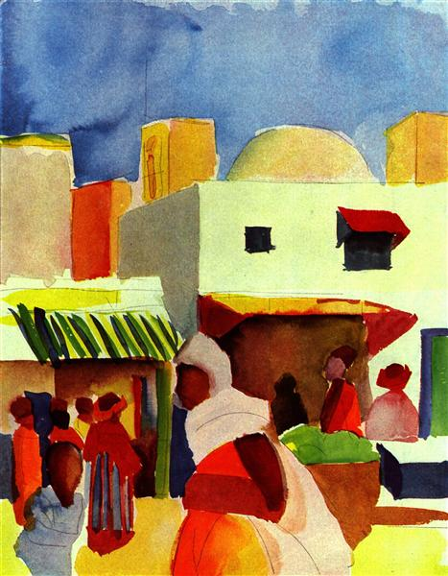
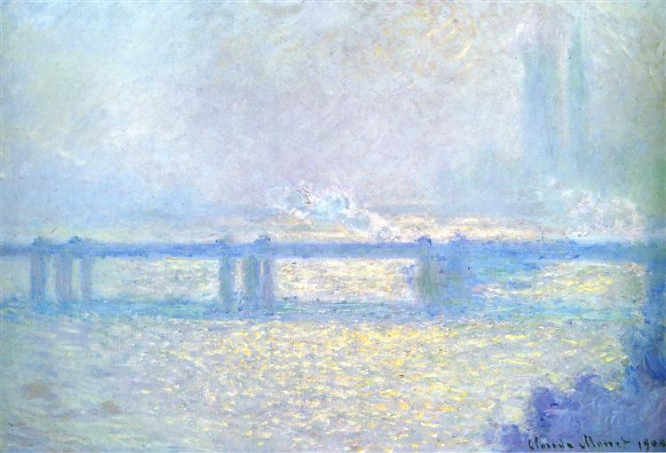
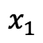
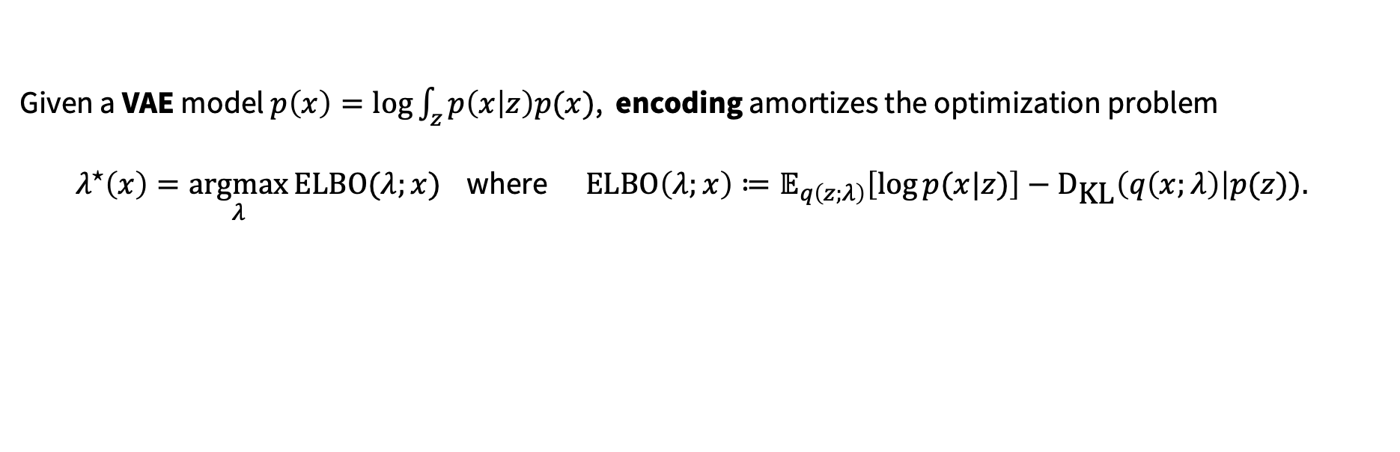
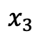
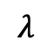
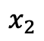
Applications of amortized optimization
Tutorial on amortized optimization for learning to optimize over continuous domains. Amos, Foundations and Trends in Machine Learning 2023.
Reinforcement learning and control (actor-critic methods, SAC, DDPG, GPS, BC)
Variational inference (VAEs, semi-amortized VAEs)
Given a VAE model $p\left(x\right)=\log{\int_{z}{p\left(x | z\right)p(x)}}$, encoding amortizes the optimization problem
$λ^{⋆}\left(x\right)=\underset{λ}{argmax}{\text{ELBO}(λ;x)}$ where $\text{ELBO}\left(λ;x\right)≔𝔼_{q\left(z;λ\right)}\left[\log{p(x|z})\right]−{\text{D}}_{\text{KL}}\left(q\left(x;λ\right)\right|p(z)).$
$$x_{1}$$
$$x_{2}$$
$$x_{3}$$
$$λ$$

Slide 17
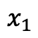
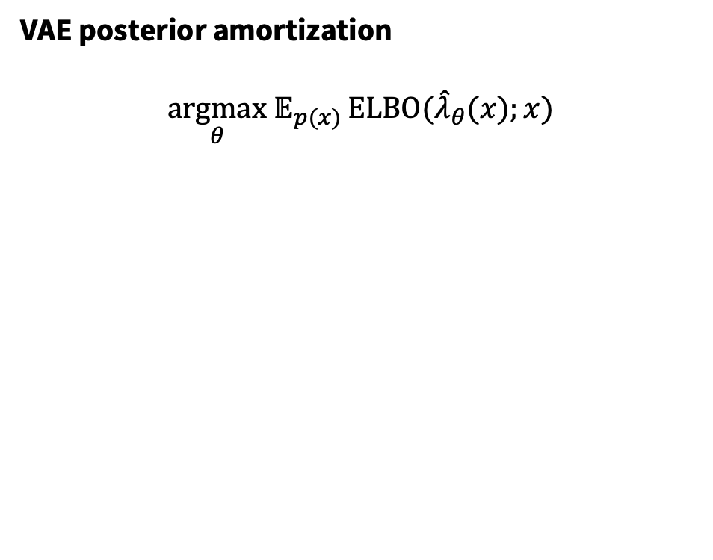
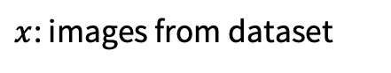
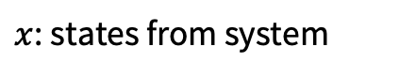
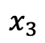
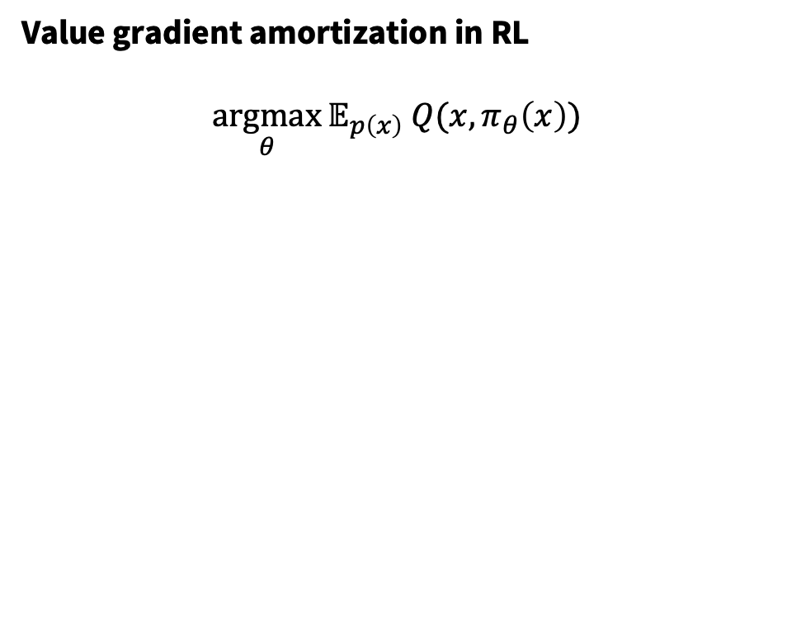
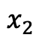
VAE amortization is conceptually the same as RL
Value gradient amortization in RL
$$\underset{θ}{argmax}{𝔼_{p\left(x\right)} Q(x, π_{θ}\left(x\right))}$$
VAE posterior amortization
$$\underset{θ}{argmax} 𝔼_{p(x)}{\text{ELBO}({\hat{λ}}_{θ}(x);x)}$$
$x$: states from system
$x$: images from dataset
$$x_{1}$$
$$x_{2}$$
$$x_{3}$$

Slide 18
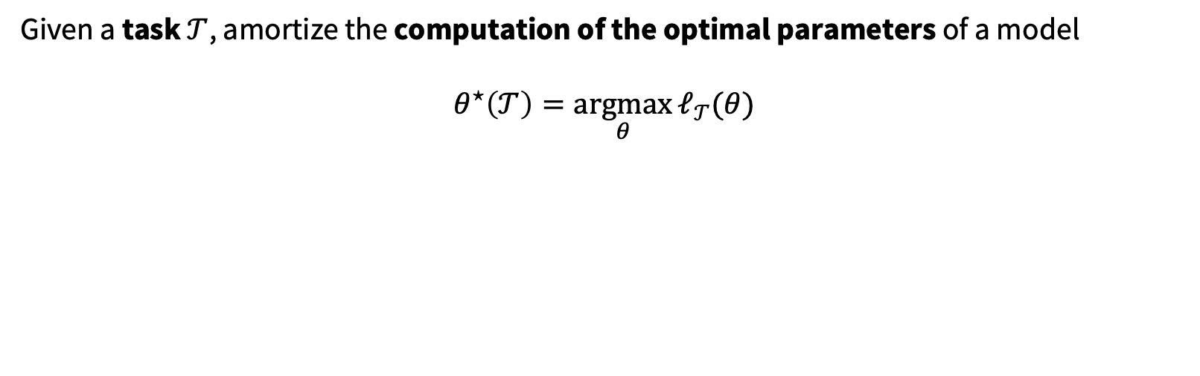
Applications of amortized optimization
Tutorial on amortized optimization for learning to optimize over continuous domains. Amos, Foundations and Trends in Machine Learning 2023.
Reinforcement learning and control (actor-critic methods, SAC, DDPG, GPS, BC)
Variational inference (VAEs, semi-amortized VAEs)
Meta-learning (HyperNets, MAML)
Given a task $𝒯$, amortize the computation of the optimal parameters of a model
$$θ^{⋆}\left(𝒯\right)=\underset{θ}{argmax}{ℓ_{𝒯}(θ)}$$

Slide 19
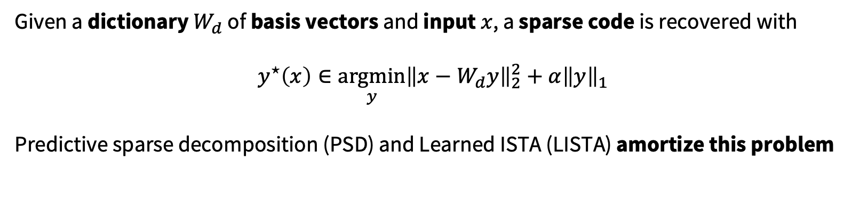
Applications of amortized optimization
Tutorial on amortized optimization for learning to optimize over continuous domains. Amos, Foundations and Trends in Machine Learning 2023.
Reinforcement learning and control (actor-critic methods, SAC, DDPG, GPS, BC)
Variational inference (VAEs, semi-amortized VAEs)
Meta-learning (HyperNets, MAML)
Sparse coding (PSD, LISTA)
Given a dictionary $W_{d}$ of basis vectors and input $x$, a sparse code is recovered with
$$y^{⋆}\left(x\right)∈\underset{y}{argmin}{{\left\|x−W_{d}y\right\|}_{2}^{2}+α{\left\|y\right\|}_{1}}$$
Predictive sparse decomposition (PSD) and Learned ISTA (LISTA) amortize this problem
Kavukcuoglu, Ranzato, and LeCun, 2010.
Gregor and LeCun, 2010.

Slide 20
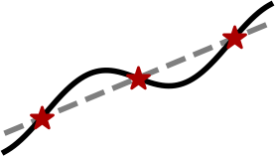
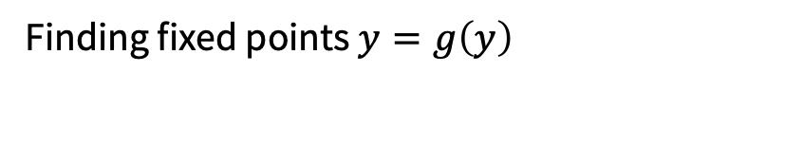

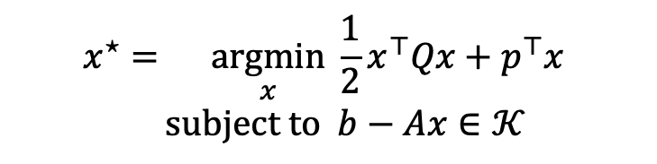
Applications of amortized optimization
Tutorial on amortized optimization for learning to optimize over continuous domains. Amos, Foundations and Trends in Machine Learning 2023.
Reinforcement learning and control (actor-critic methods, SAC, DDPG, GPS, BC)
Variational inference (VAEs, semi-amortized VAEs)
Meta-learning (HyperNets, MAML)
Sparse coding (PSD, LISTA)
Roots, fixed points, and convex optimization (NeuralDEQs, RLQP, NeuralSCS)
$$x^{⋆}=\underset{x}{argmin}{{\frac{1}{2}x^{⊤}Qx+p}^{⊤}x} \\ subject to b−Ax∈𝒦$$
Finding fixed points $y=g\left(y\right)$
KKT conditions
Find $z^{⋆}$ s.t. $ℛ\left(z^{⋆}, θ\right)=0$

Slide 21
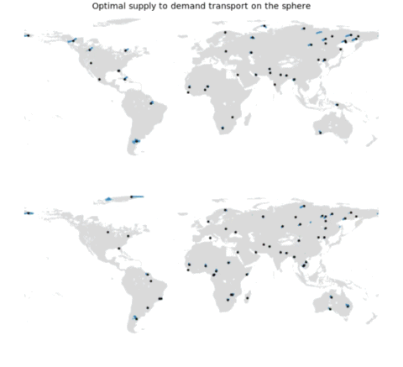
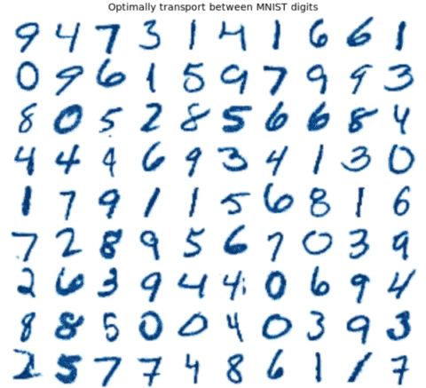
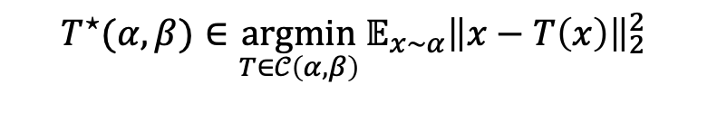
Applications of amortized optimization
Tutorial on amortized optimization for learning to optimize over continuous domains. Amos, Foundations and Trends in Machine Learning 2023.
Reinforcement learning and control (actor-critic methods, SAC, DDPG, GPS, BC)
Variational inference (VAEs, semi-amortized VAEs)
Meta-learning (HyperNets, MAML)
Sparse coding (PSD, LISTA)
Roots, fixed points, and convex optimization (NeuralDEQs, RLQP, NeuralSCS)
Optimal transport (slicing, conjugation, Meta Optimal Transport)
$${T^{⋆}(α, β)∈\underset{T∈𝒞\left(α, β\right)}{argmin}{𝔼_{x∼α}\left\|x−T\left(x\right)\right\|}}_{2}^{2}$$
Meta Optimal Transport. Amos et al., ICML 2023.

Slide 22
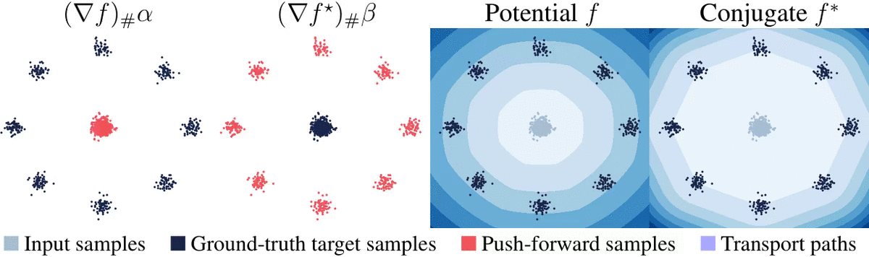
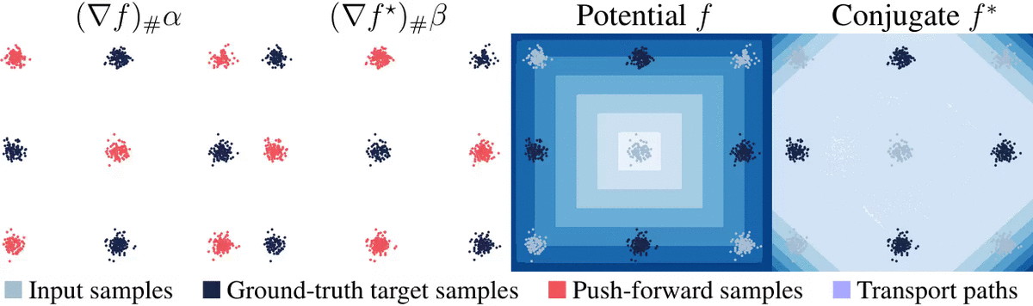



Applications of amortized optimization
Tutorial on amortized optimization for learning to optimize over continuous domains. Amos, Foundations and Trends in Machine Learning 2023.
Reinforcement learning and control (actor-critic methods, SAC, DDPG, GPS, BC)
Variational inference (VAEs, semi-amortized VAEs)
Meta-learning (HyperNets, MAML)
Sparse coding (PSD, LISTA)
Roots, fixed points, and convex optimization (NeuralDEQs, RLQP, NeuralSCS)
Optimal transport (slicing, conjugation, Meta Optimal Transport)
$$f^{c}\left(y\right)=−\inf_{x}{f\left(x\right)−x^{⊤}y}$$
On amortizing convex conjugates for optimal transport. Amos, ICLR 2023

Slide 23


Applications of amortized optimization
Reinforcement learning and control (actor-critic methods, SAC, DDPG, GPS, BC)
Variational inference (VAEs, semi-amortized VAEs)
Meta-learning (HyperNets, MAML)
Sparse coding (PSD, LISTA)
Roots, fixed points, and convex optimization (NeuralDEQs, RLQP, NeuralSCS)
Optimal transport (slicing, conjugation, Meta Optimal Transport)
Foundations and Trends® in Machine Learning

Slide 24
Future directions and limitations
Amortized optimization is established and budding with new methods and applications
Possible to expand far beyond unconstrained continuous Euclidean optimization settings:
1. New applications and settings for semi-amortized modeling
2. Constrained domains (e.g., with differentiable projections)
3. Discrete optimization settings (e.g., with differentiable discrete optimization)
4. Non-Euclidean settings (e.g., with Riemannian optimization)
Potential limitations:
1. Difficult in out-of-domain settings when the contexts significantly change
2. Generally difficult to ensure stability or convergence
3. Typically does not solve previously intractable problems
4. Can be difficult to obtain high-accuracy solutions without fine-tuning/semi-amortization

Slide 25

Amortized optimization
Brandon Amos
Meta AI NYC, Fundamental AI Research (FAIR)
brandondamos
bamos.github.io
github.com/facebookresearch/amortized-optimization-tutorial
github.com/bamos/presentations
The differentiable cross-entropy method [Amos and Yarats, ICML 2020]
Neural Potts Model [Sercu*, Verkuil*, et al., MLCB 2020]
On the model-based stochastic value gradient [Amos, Stanton, Yarats, Wilson, L4DC 2021]
Online planning via RL fine-tuning [Fickinger*, Hu*, et al., NeurIPS 2021]
Neural fixed-point acceleration [Venkataraman and Amos, ICML AutoML Workshop, 2021]
On amortizing convex conjugates for optimal transport [Amos, ICLR, 2023]
Meta Optimal Transport [Amos, Cohen, Luise, Redko, ICML 2023]
Tutorial on amortized optimization [Amos, Foundations and Trends in ML, 2023]

